Slide 1
Data Preparation 1
Converting integer coded variables to descriptive variables

Slide 2
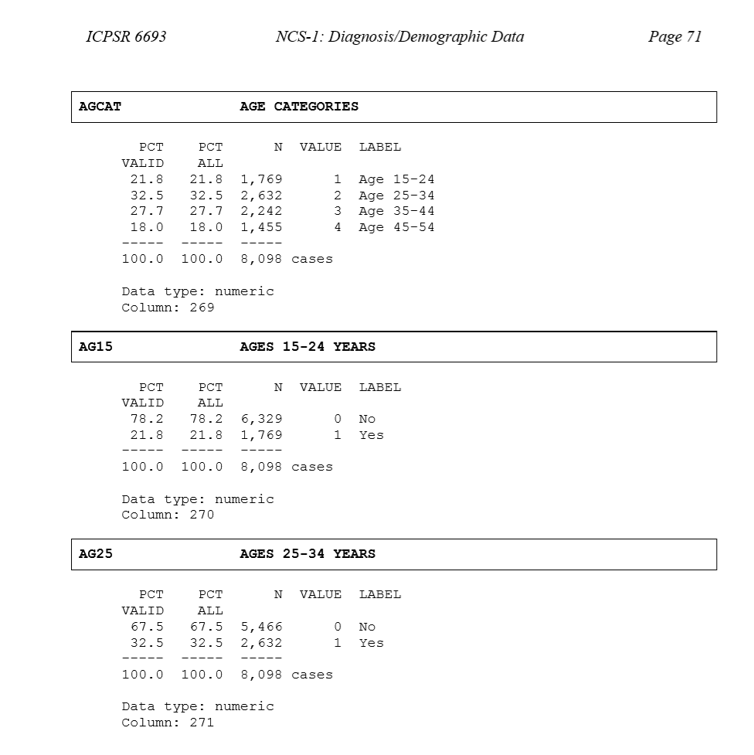
Category labels available in PDF codebooks

Slide 3
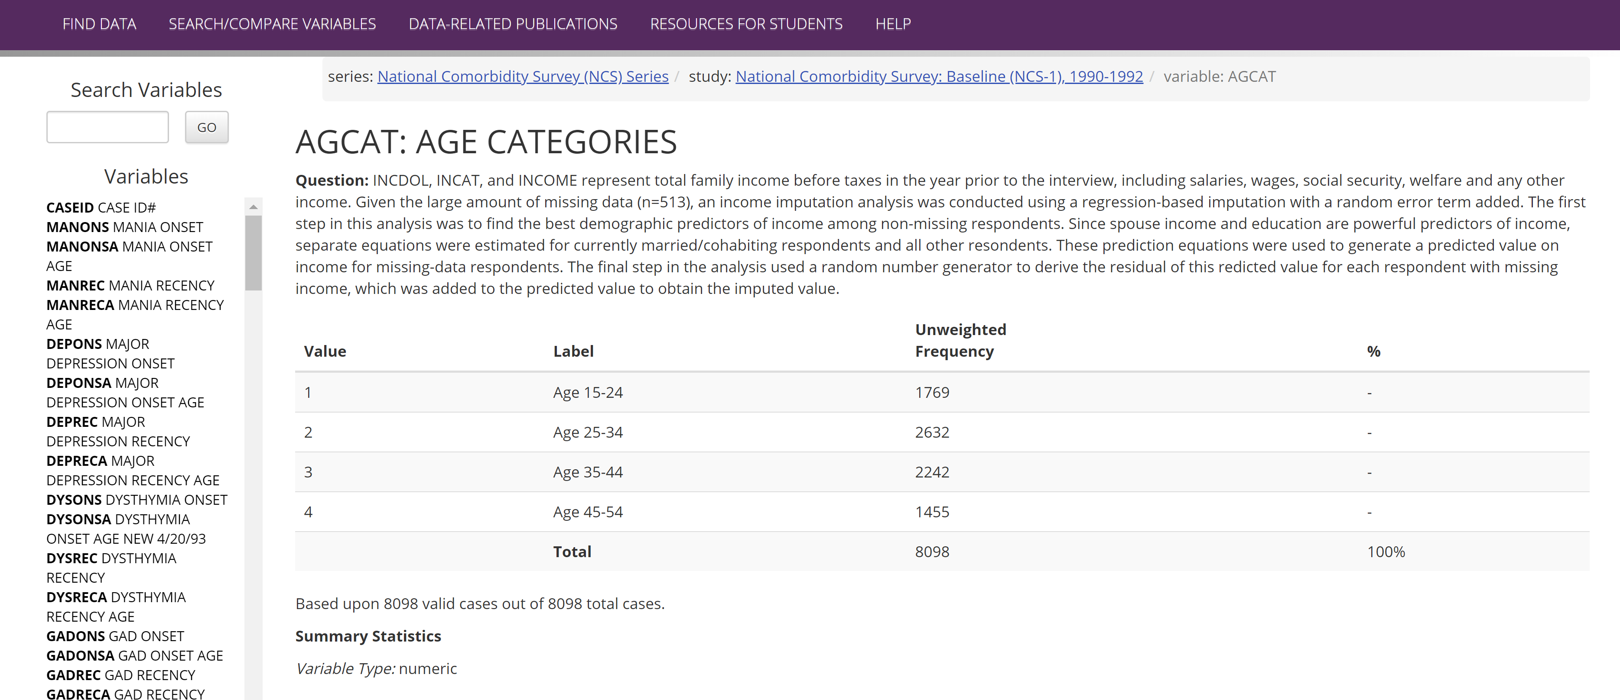
Category labels available online

Slide 4
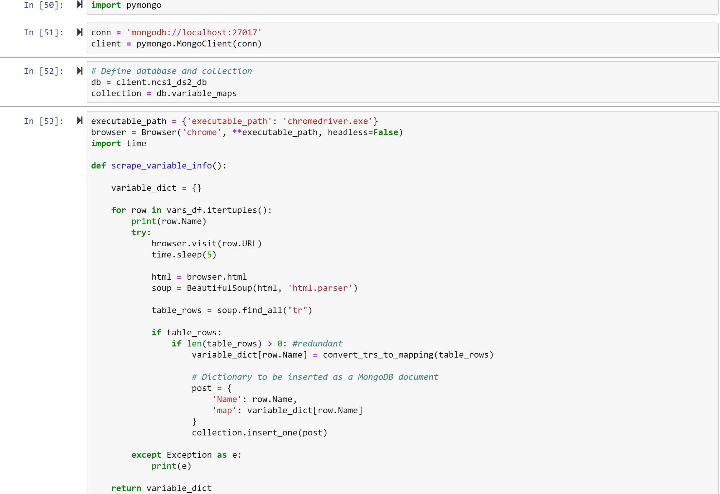
Solution: Scrape tables and convert to Python dictionaries

Slide 5
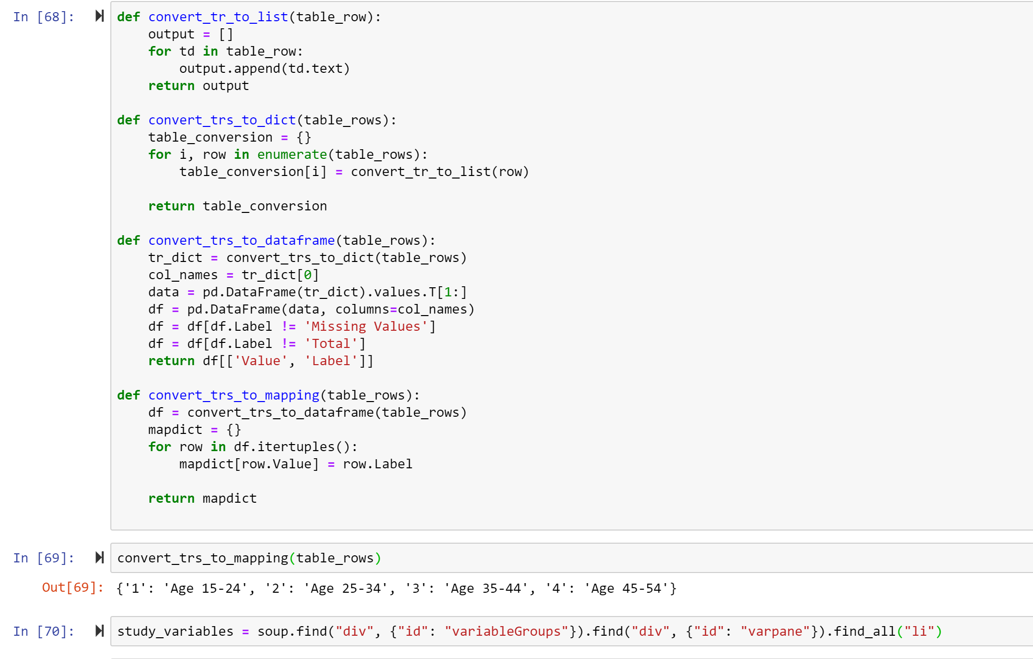
Converting HTML table to Python Dict

Slide 6
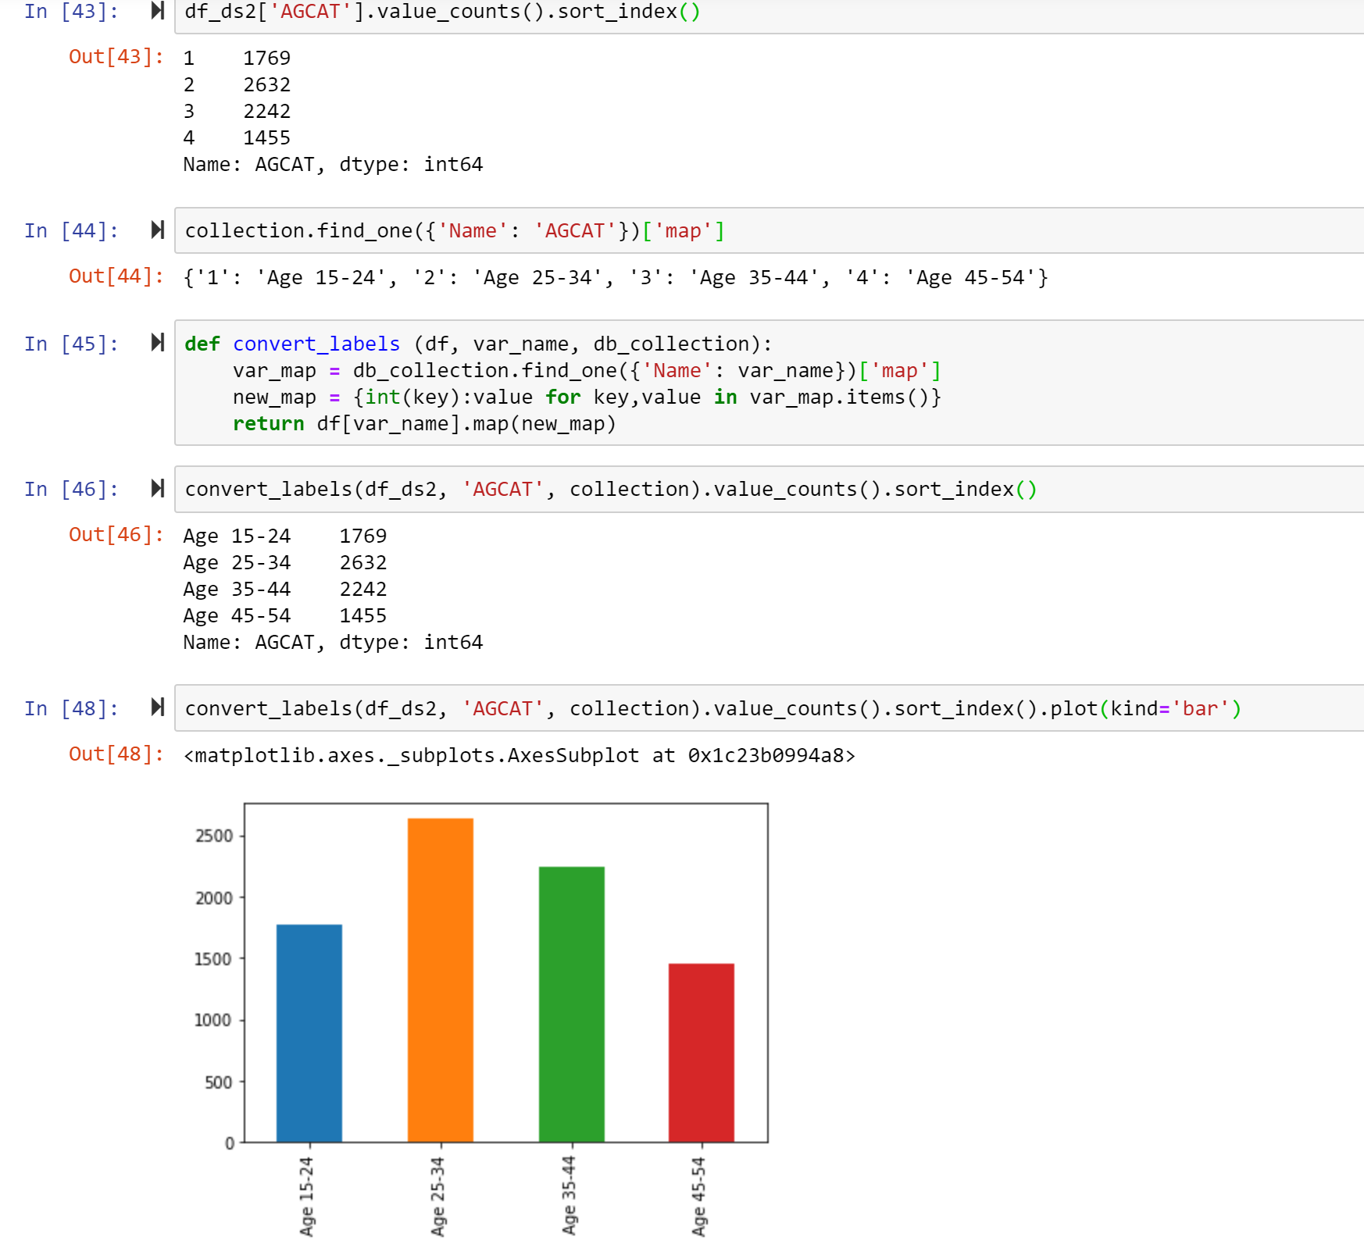

Slide 7
Data Preparation 2
Remove all missing values by case. This leaves only 1345 full cases.
Identify relevant predictors from literature. 30 factors are considered; only one is numerical. Some are ordinal in nature; however, we treat them as categorical.
Convert categorical predictors to one-hot encoded using pandas.get_dummies(). This increases the number of predictors to 118 – all but one predictor is 0-1-valued.
Scale the predictors.

Slide 8
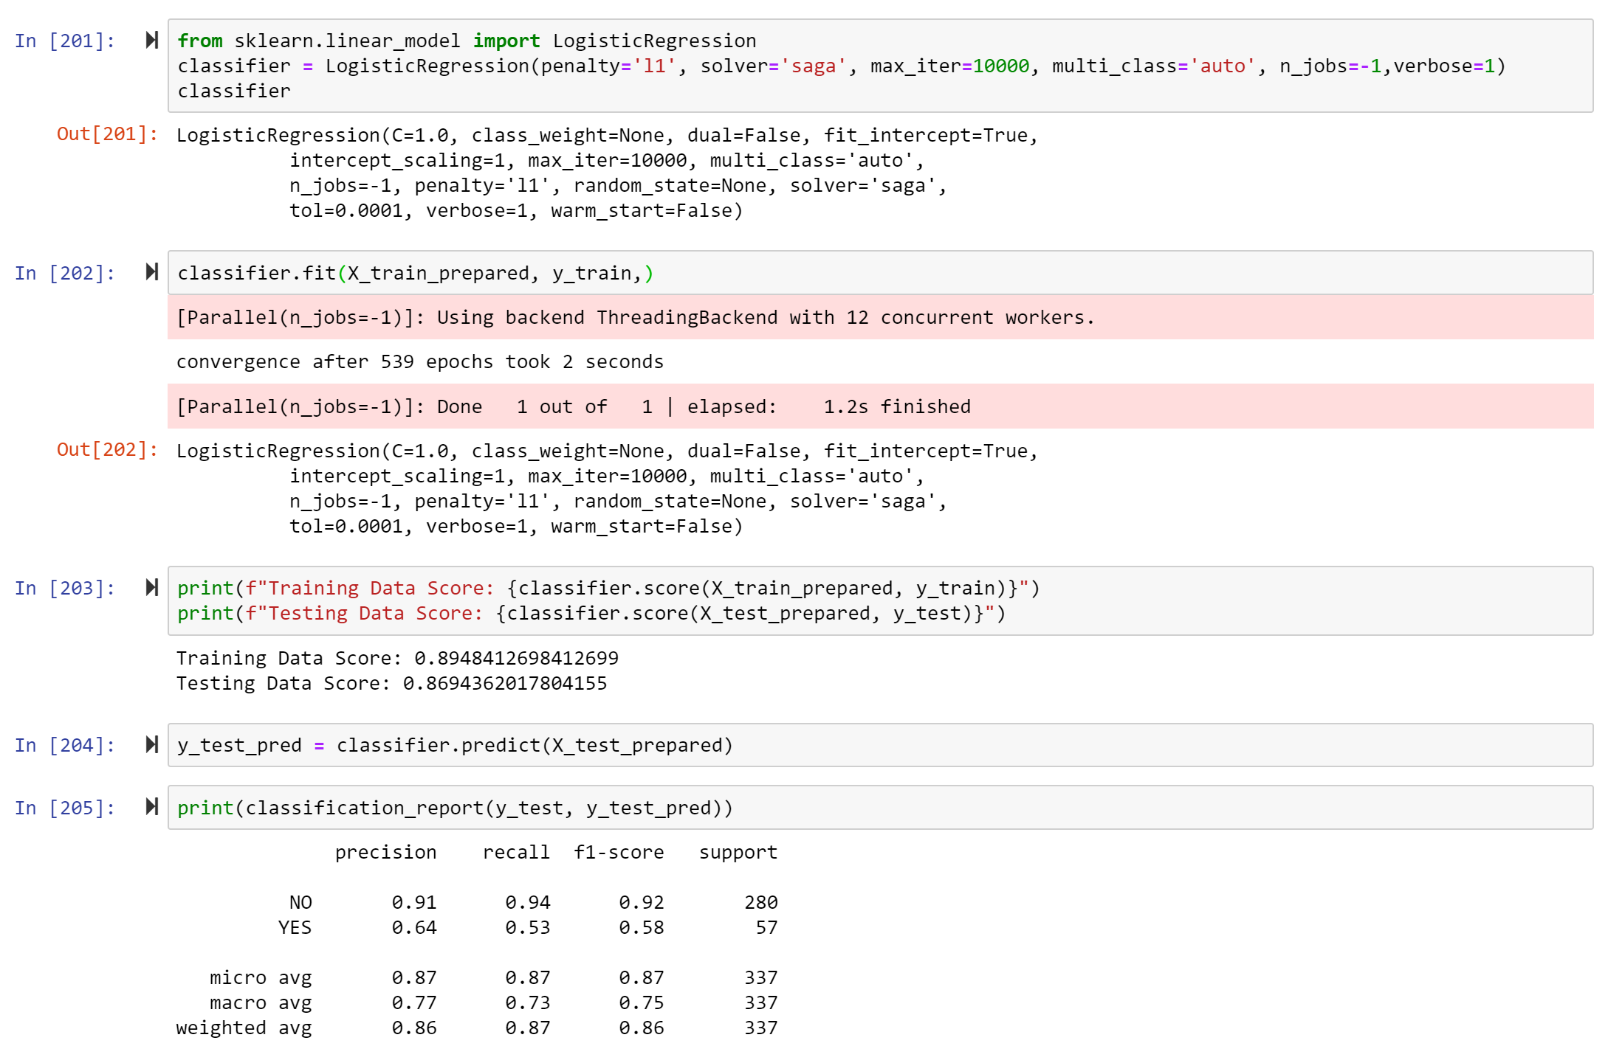
Logistic Regression with L1-regularization

Slide 9
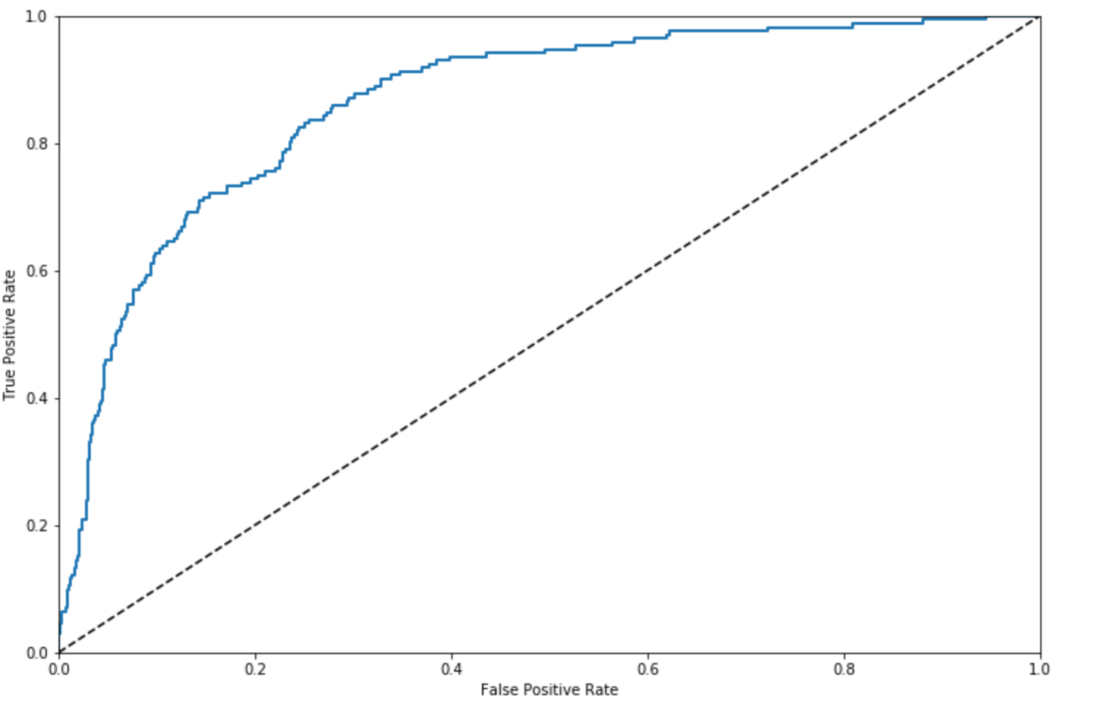
The ROC curve of our classifier

Slide 10
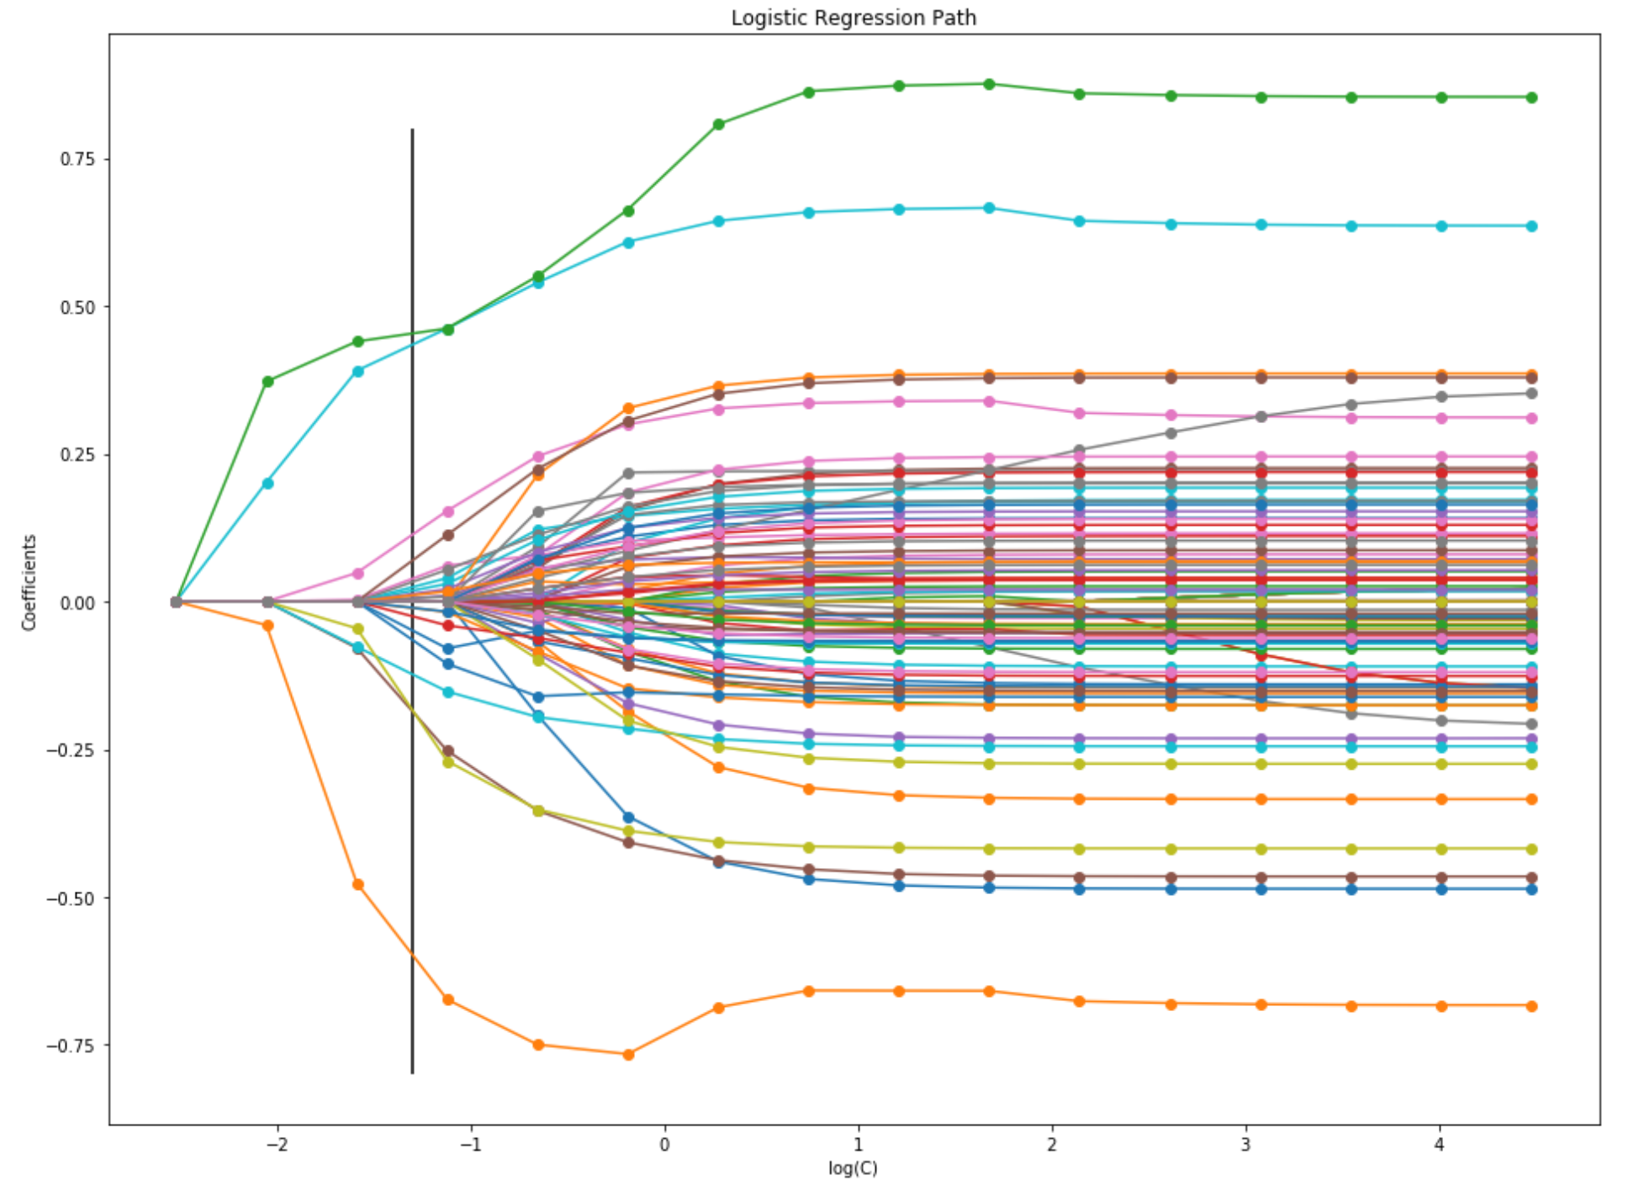
L1-regularization path
Moving from right to left, the paths show how the parameters shrink with the increasing penalization.
The vertical line at C = 0.05 corresponds to the best parameter choice as found by GridSearchCV.
Credit: Alexandre Gramfort <alexander.gramfort@inria.fr>

Slide 11
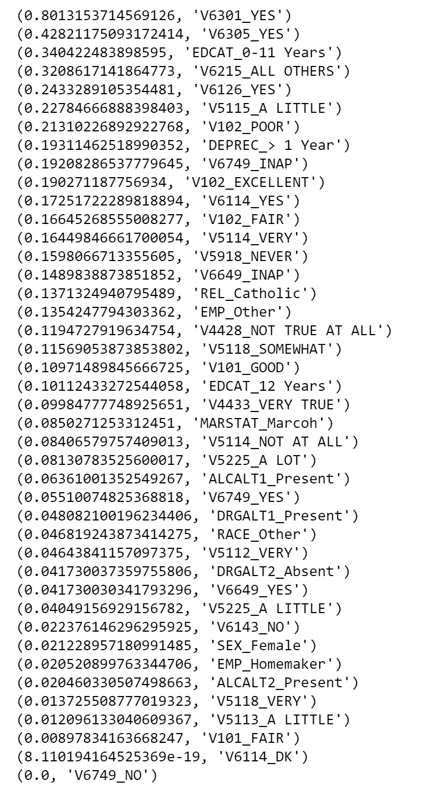
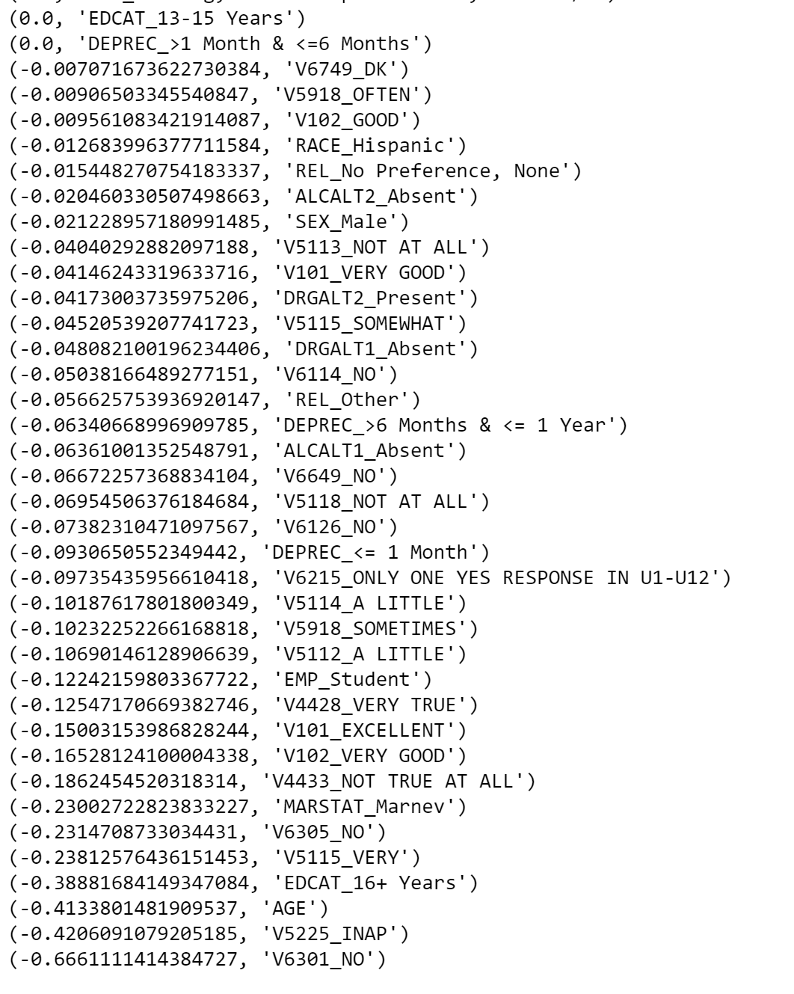
Feature importances

Slide 12
Identifying the relevant features
The best model as chosen by GridSearchCV has C=1. For this model, there are 63 non-zero parameters. Some of the more important predictors are: V6301, V6305, V5225, V102, EDCAT, V6215, V5115, DEPREC, and V6126.

